Slide 1

Midterm project proposal
Katherine Li

Slide 2
Concept/Theme
Portfolio site
Demonstrate previous projects
Who i am
Simple

Slide 3
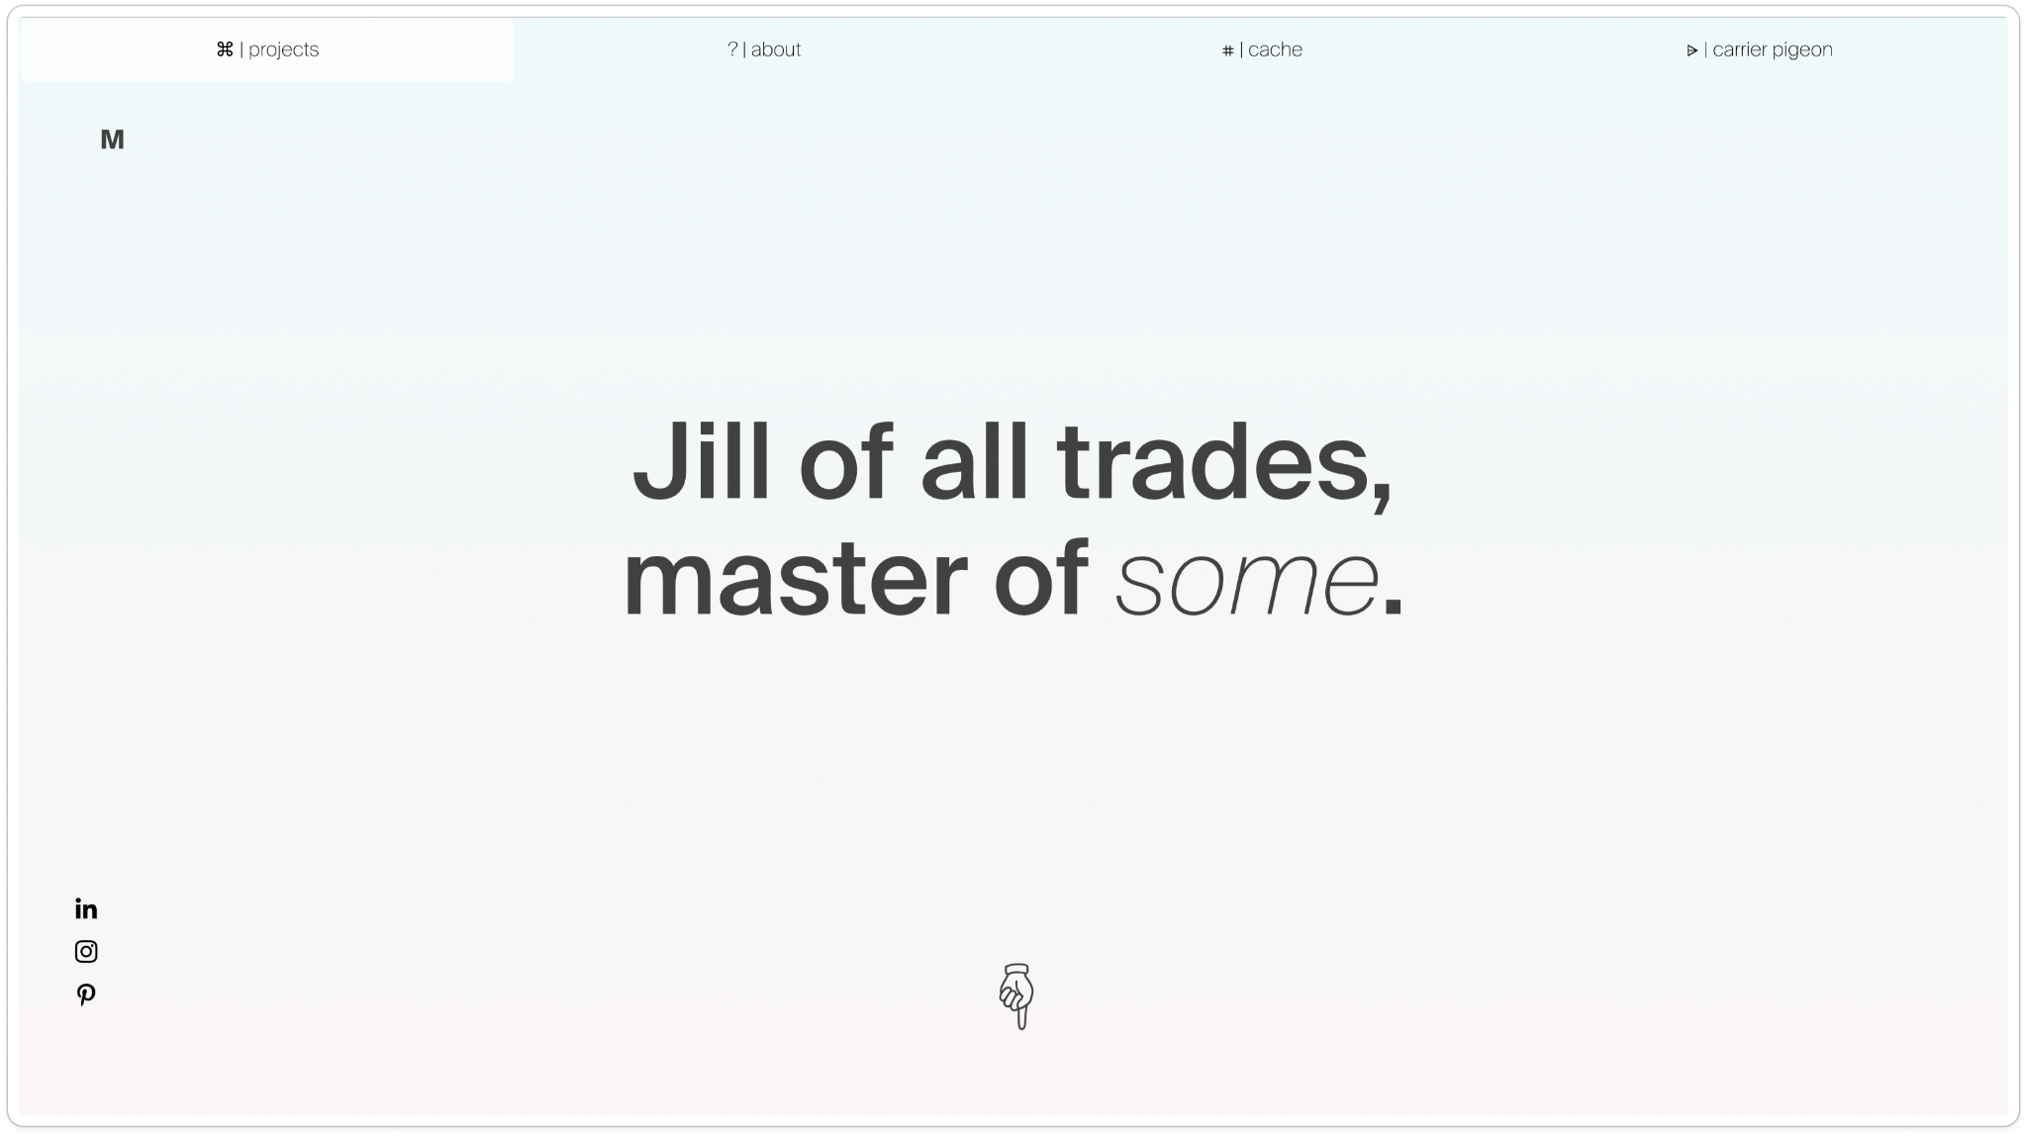
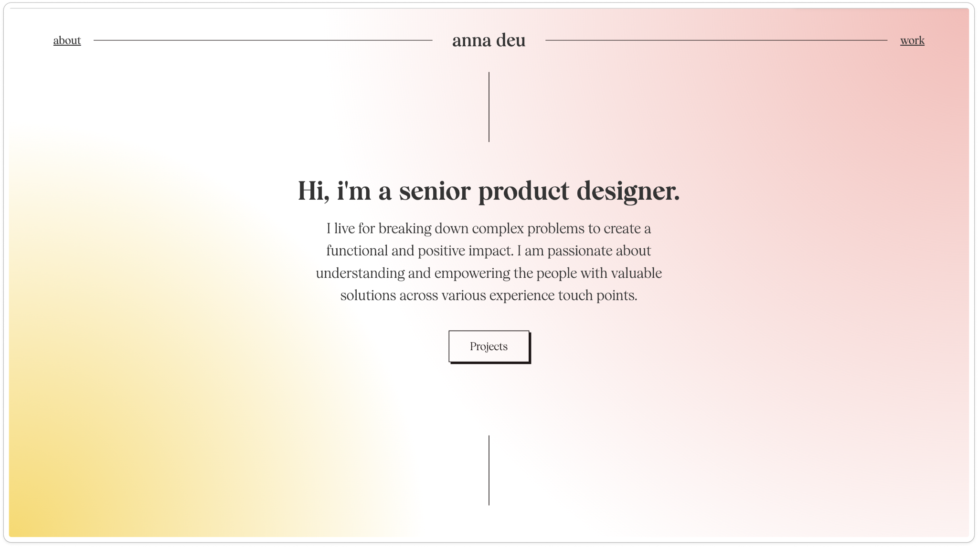

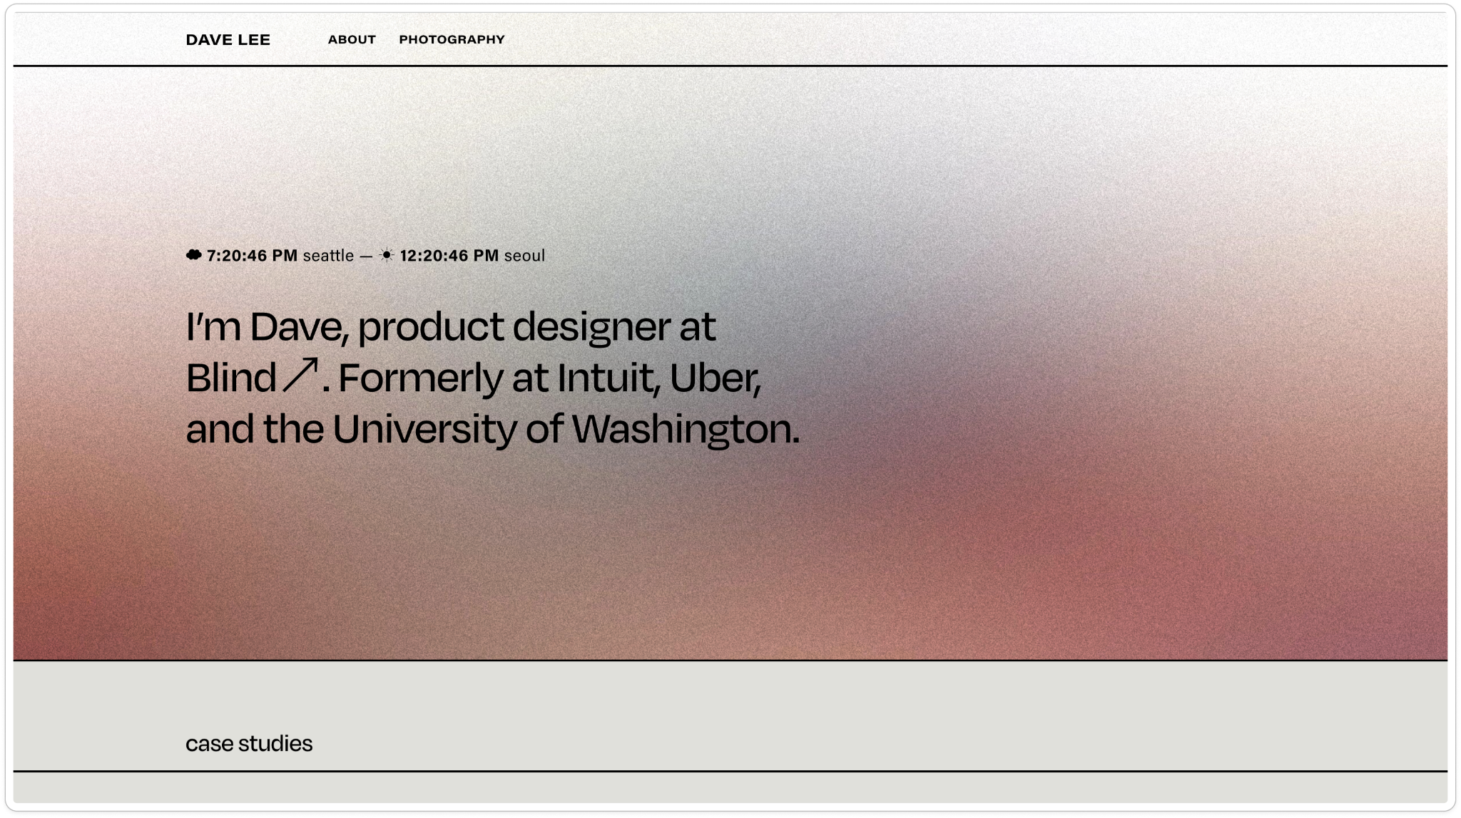
Notes:
https://www.leedave.com/
https://www.huiranli.com/
https://www.annadeu.com/
https://www.michaellatwersky.com/

Slide 4

Color&Type

Slide 5
Skills
Covered:
To learn:
Nav bar
Media queries
Box model
Positioning
Events
Flexbox
Linking back to the top of the page
Animation on hover(?)

Slide 6
Desktop/mobile Wireframe
Notes:
https://www.figma.com/proto/xh4QOw1u4noXTm8Ql1kTZ1/VFS-final?type=design&node-id=16-8&t=xGNxW9Htk30NZFfd-0&scaling=scale-down&page-id=0%3A1&starting-point-node-id=16%3A8&show-proto-sidebar=1
https://www.figma.com/proto/U2IKl64TuSuAGSBXYSmBNF/Mobile-wireframe?type=design&node-id=1-2&t=ryWIR7afoWxKA9FR-0&scaling=scale-down&page-id=0%3A1&starting-point-node-id=1%3A2

